Slide 1
A PROJECT ON SQL SHOWMAN HOUSE
Designed, implemented and tested by
Babatola .a. Emmanuel &
emmanuel

Slide 2
CERTIFICATE
THIS IS TO CERTIFY THAT THIS PROJECT WAS DONE AND CREATED BY
BABATOLA EMMANUEL &
EMMANUEL

Slide 3
CONCEPTS
Database engine
Schema
Tables
Constraints
Indexes
Views
Triggers
Security logins
Database backups
variables

Slide 4
OBJECTIVES
The aim of this project is To create a computerized event management system for Showman House with the necessary requirements mentioned in the concepts

Slide 5
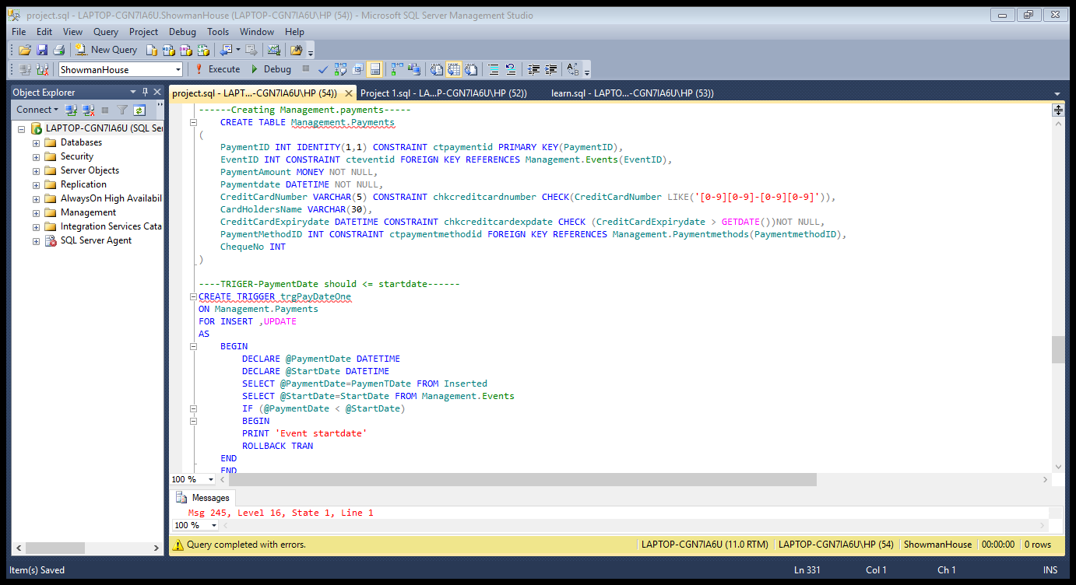
VIEWOF THE CODE

Slide 6
APPRECIATION
We want to use this opportunity to say thank you to my Faculty who has contributed hugely in learning of the SQL programme in NIIT. we also want to say thank you to my fellow colleges and a special thanks to MR KACHI

Slide 7
CONCLUSION
We have successfully the showman house database with the necessary requirements, and also the query has been made easy to understand with good detailed comments.

Slide 8
THANKS FOR WATCHING

